Slide 1
Training

Slide 2

Introduction
Welcome, and thank you for participating in our study.
The introduction of whole slide images (WSIs) 20 years ago provided an immense opportunity for sharing and for algorithms to assist pathologists’ reading tasks. Today, we invite you to review 120 WSIs for us to capture how you as an expert examine these complex images. The experiment will consist of three parts: a short training session to get you familiar with the procedure of the experiment, the formal experiment, and an exit questionnaire.

Slide 3
Calibration
Before we begin, we will calibrate our eye tracker using a 9-point calibration. A white dot will appear on the screen. Please follow the dot as it moves on the screen. Please sit comfortably and do not be too close (< 0.5 meter) or too far (> 1 meter) from the screen.
We will begin calibration now

Slide 4
Training
During this training session, please ask any questions you may have. When the formal experiment begins, we will not be able to answer any questions.

Slide 5
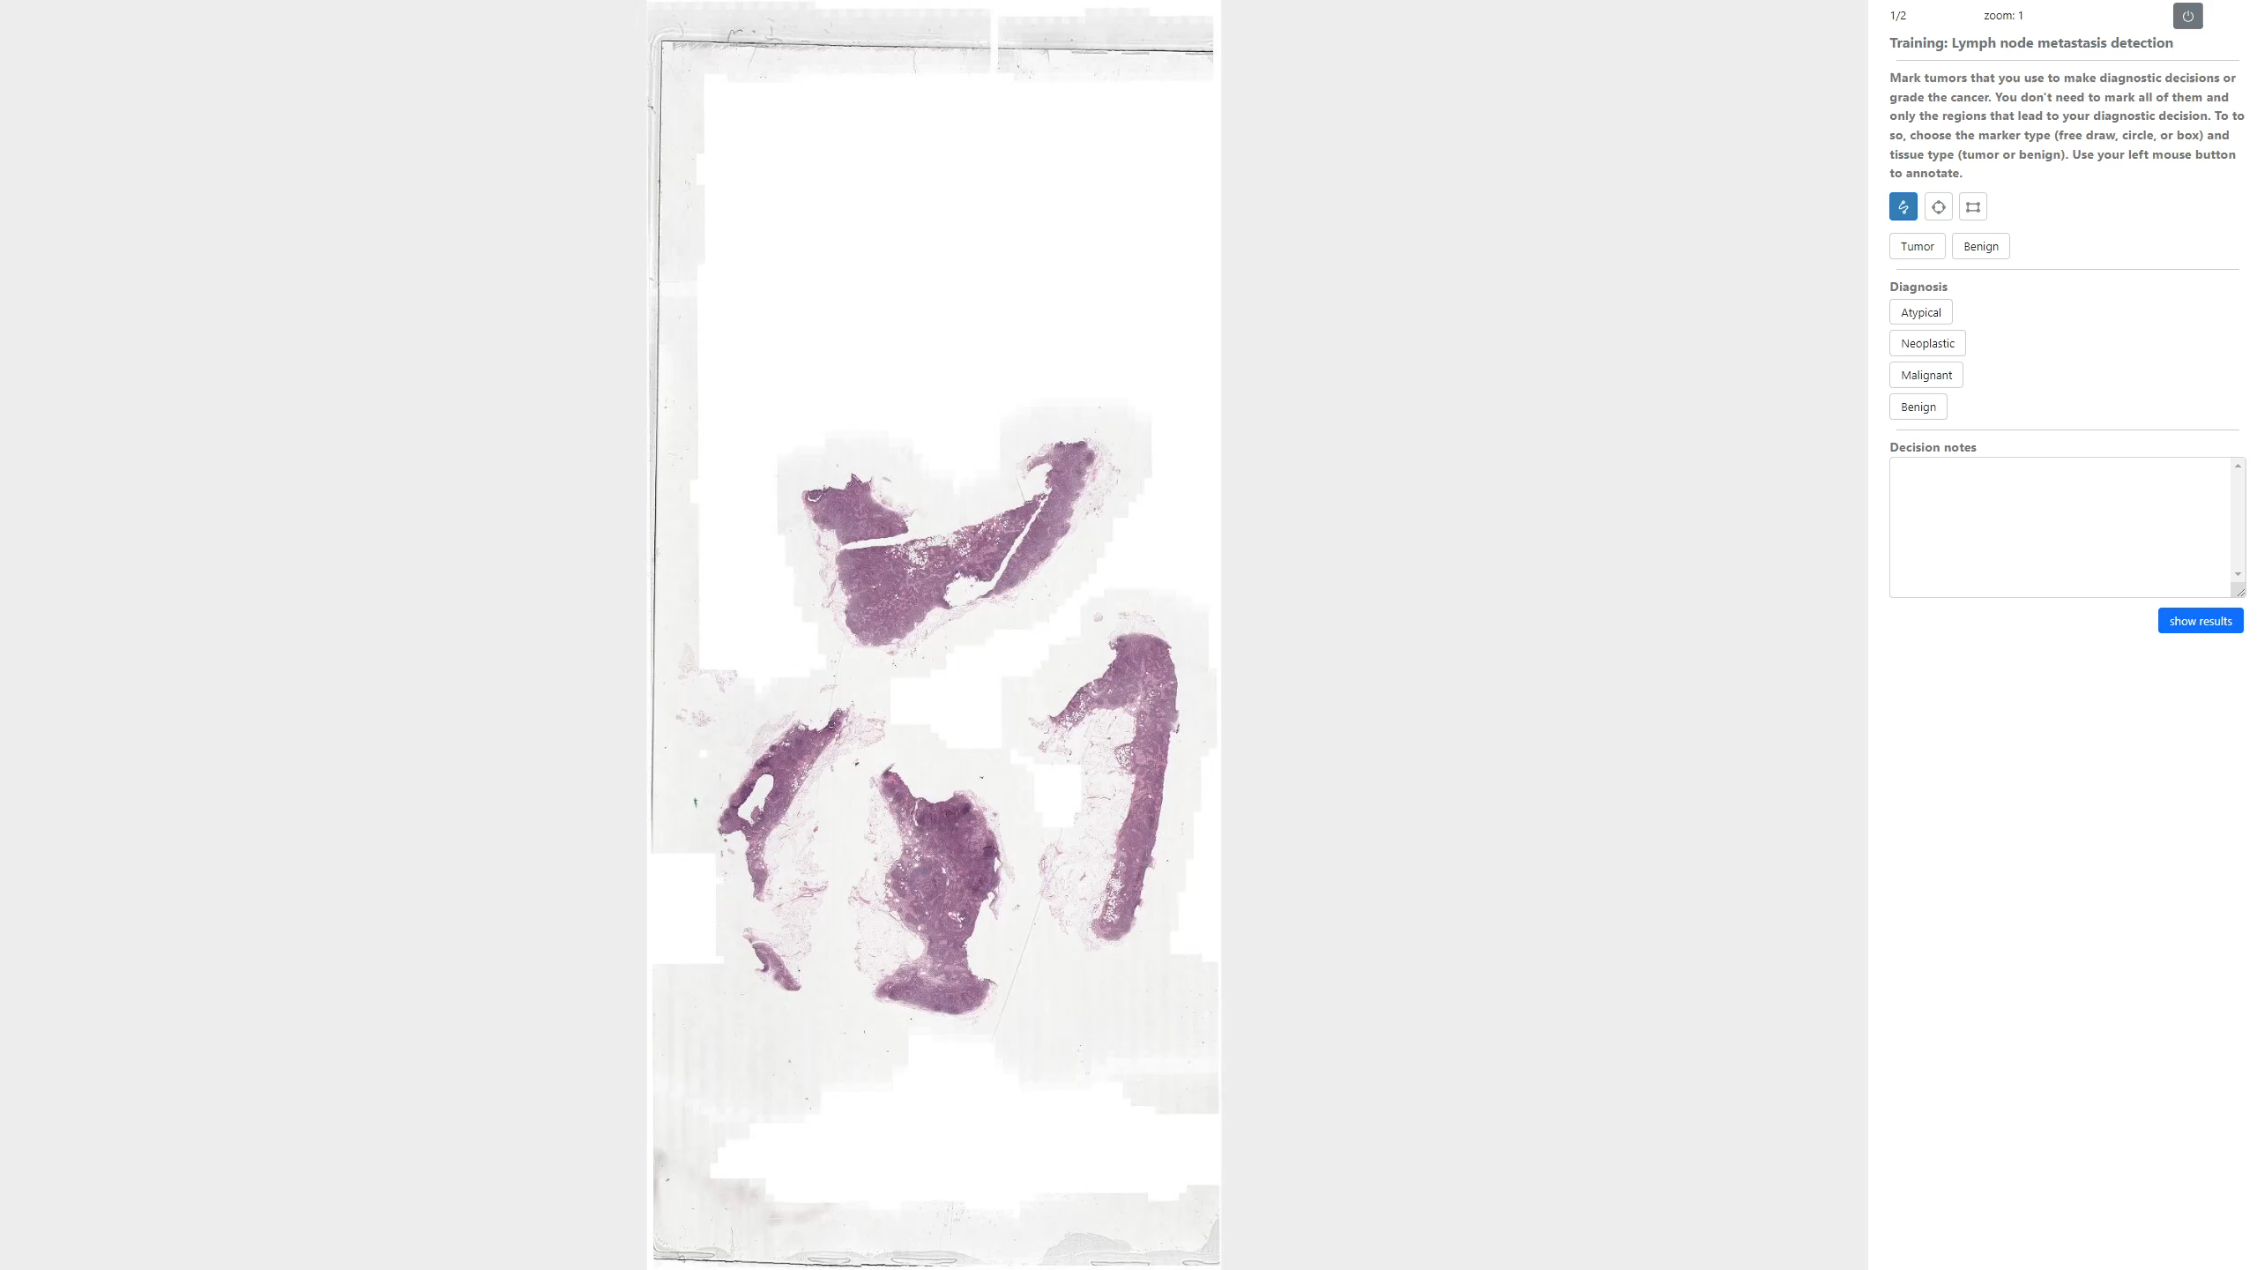
Training

Slide 6
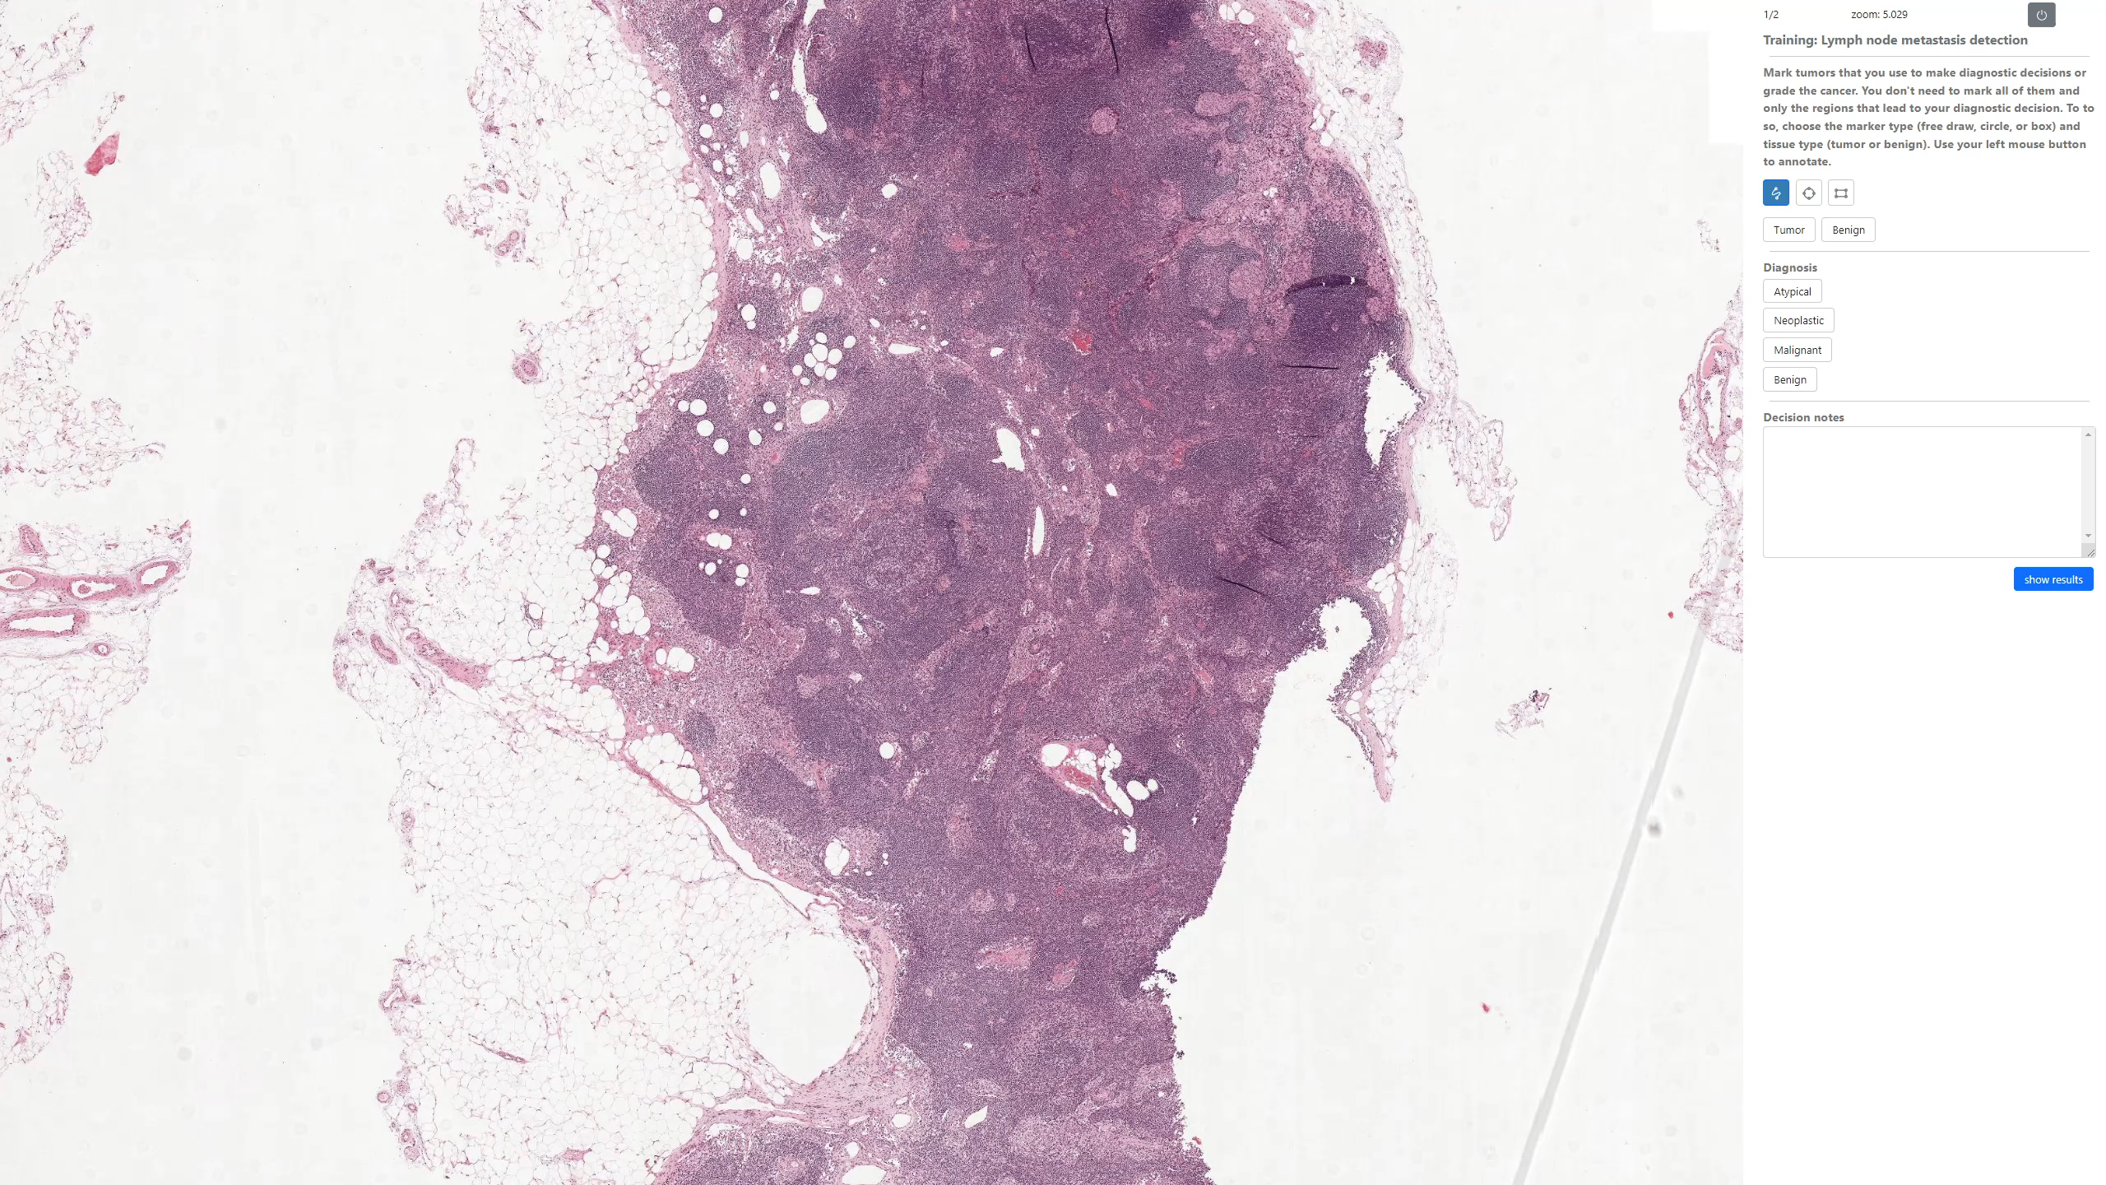
Training

Slide 7
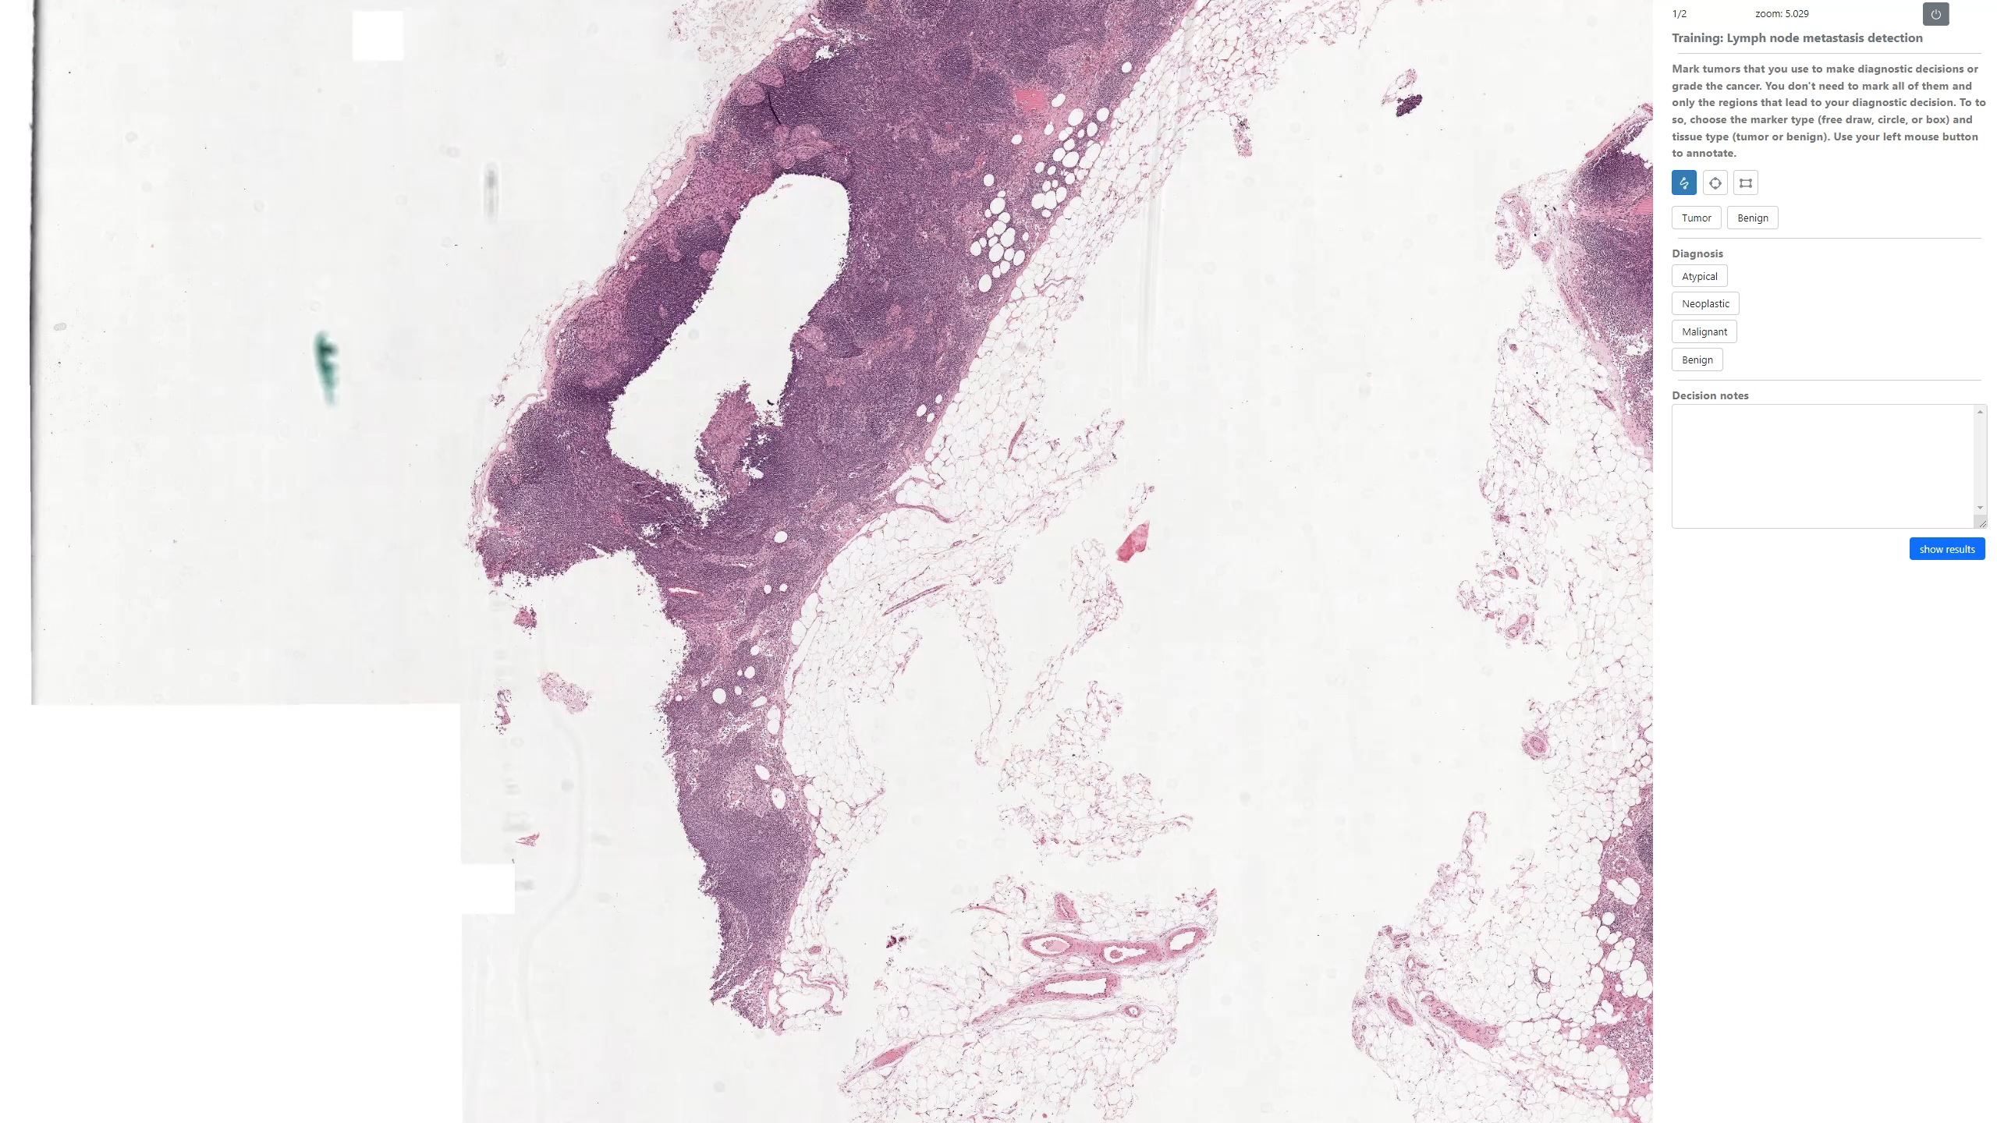
Training

Slide 8
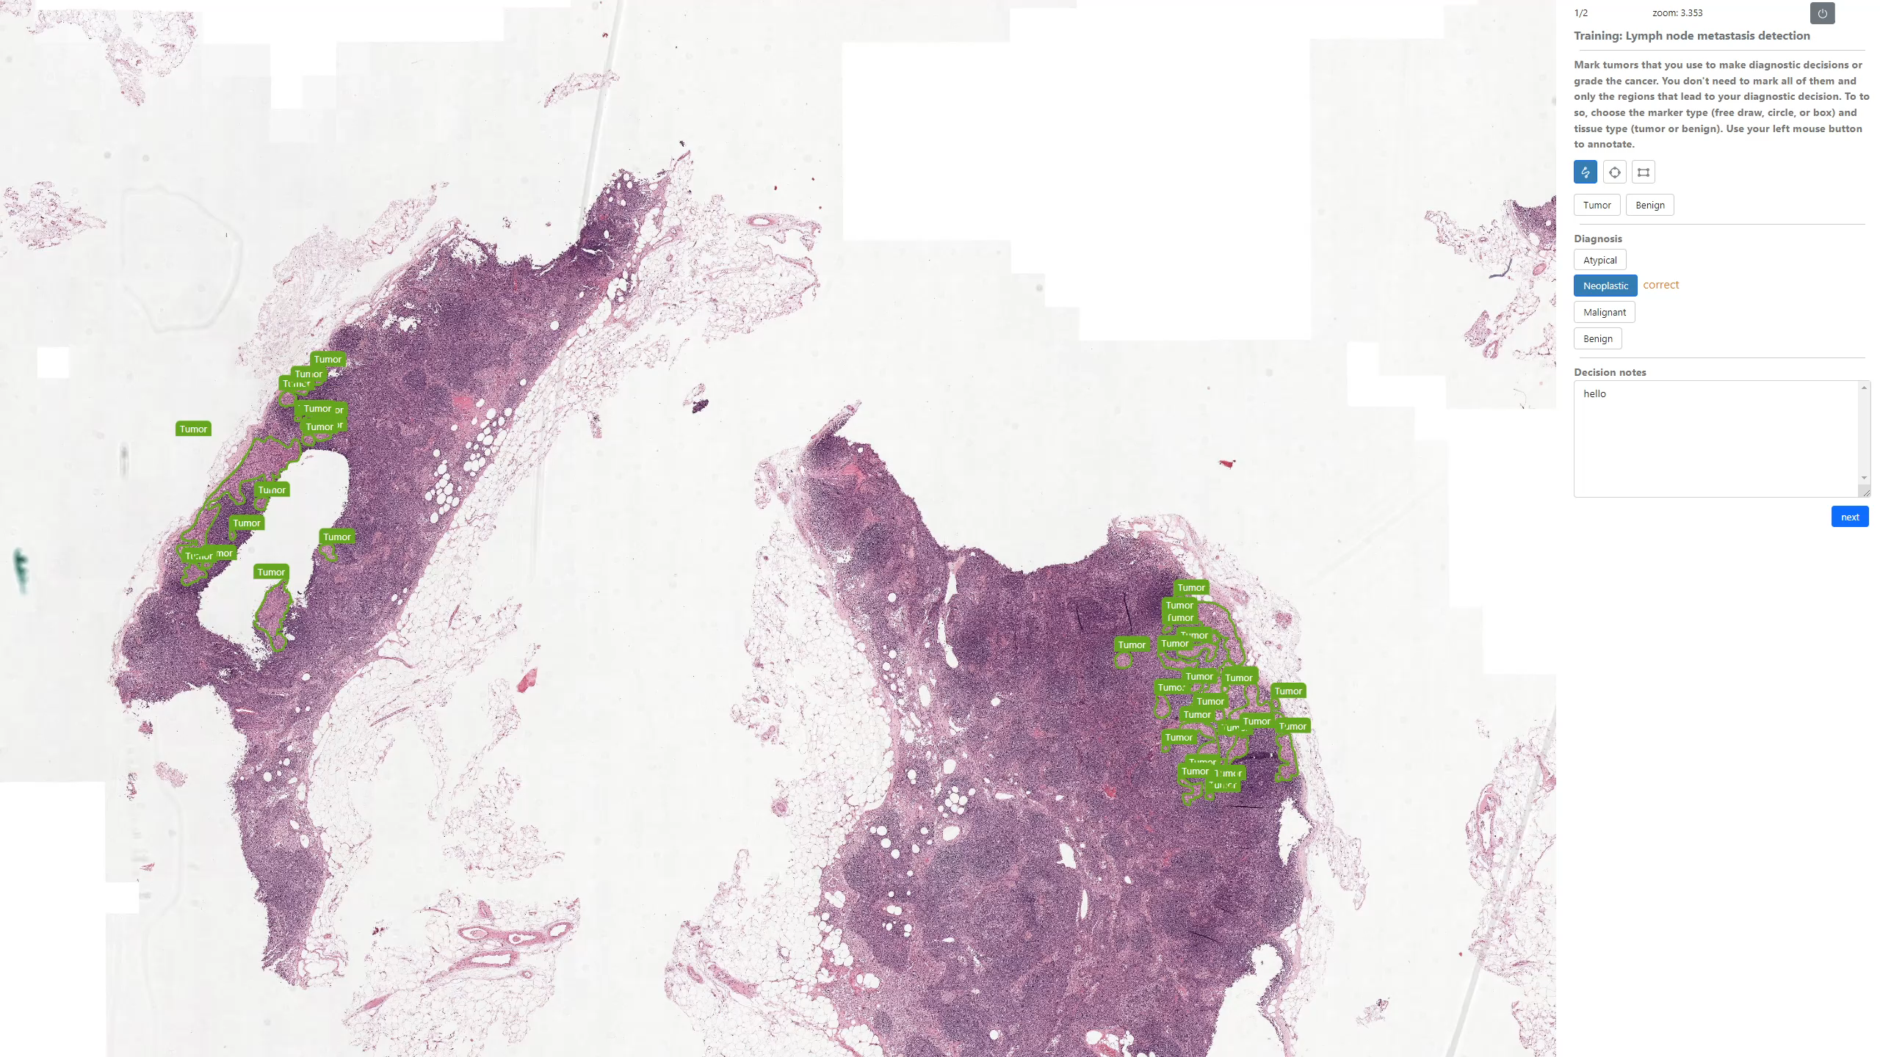
Training

Slide 9
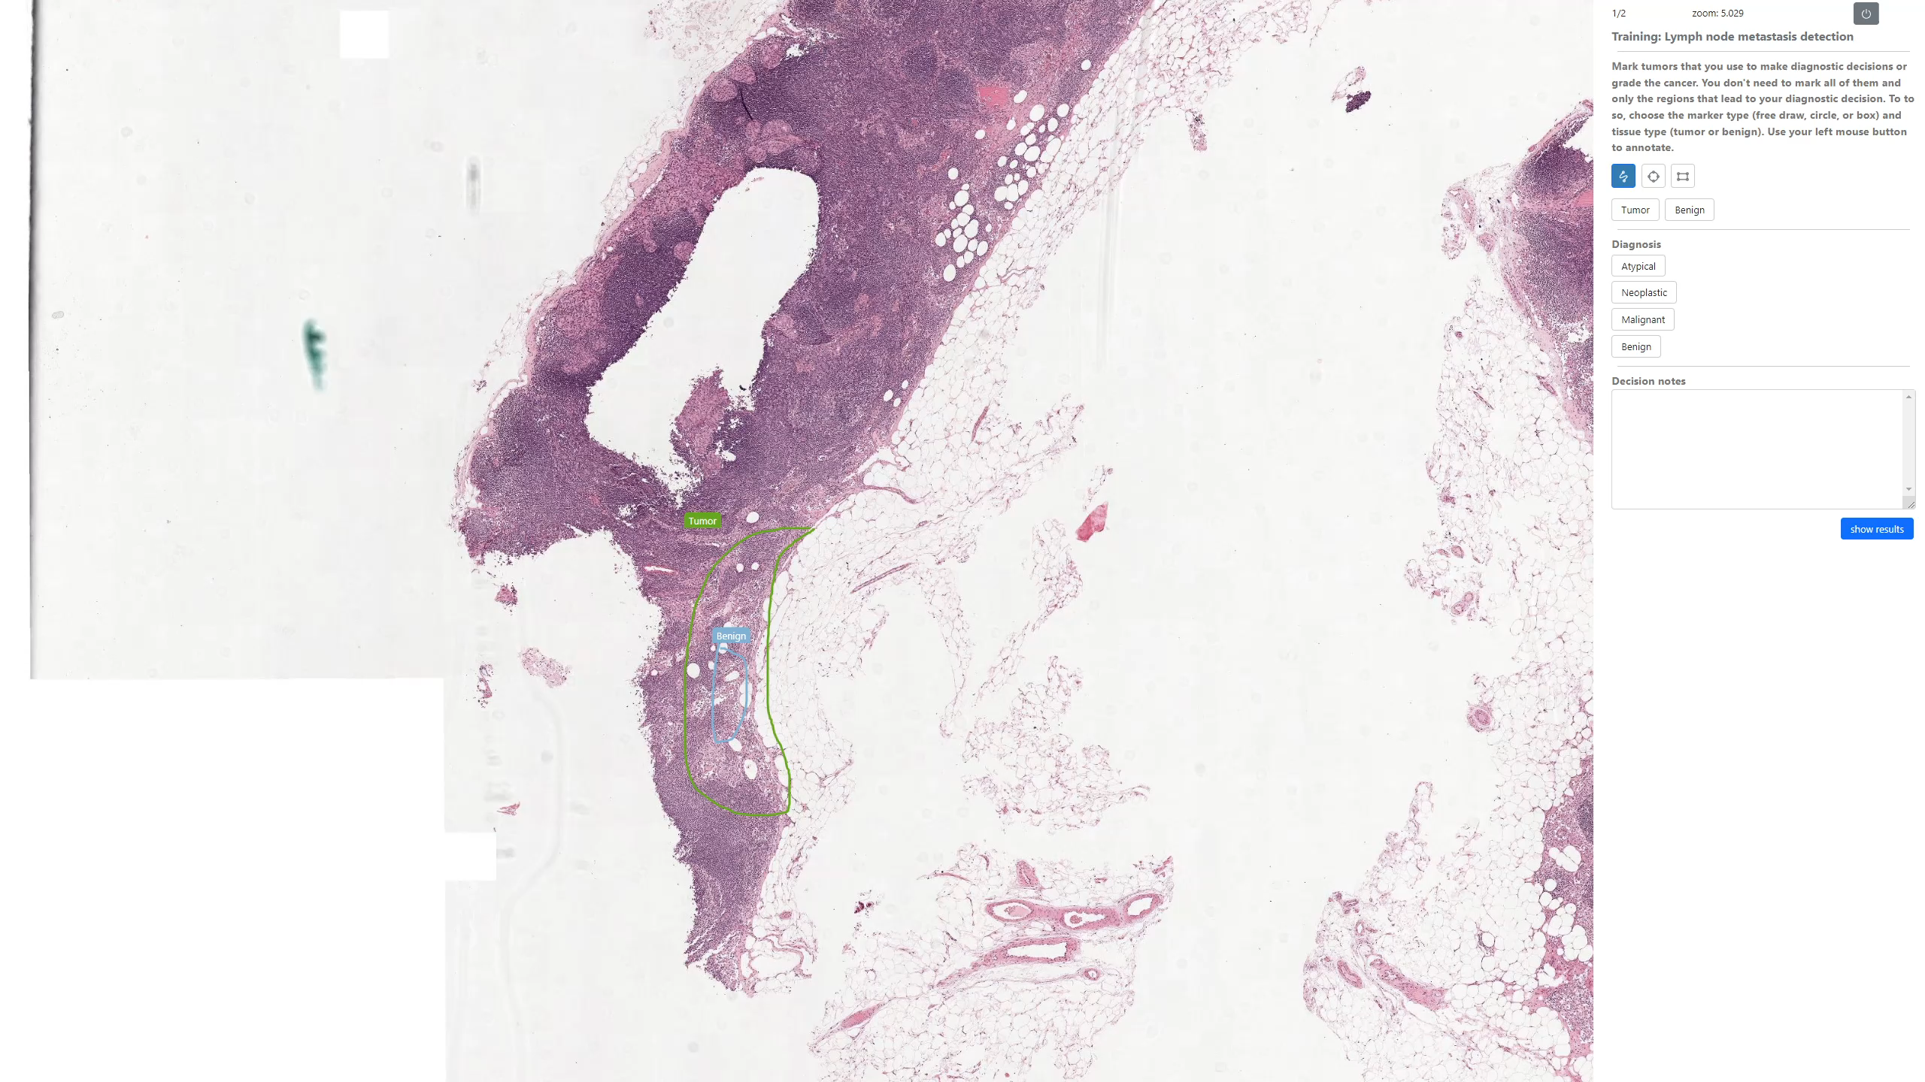
Training

Slide 10
Training
At the top of the interface is the current progress in the experiment (for example, 1/120 shows the 1st task among 120). Click the PAUSE button (the small black button) if you need a break. Please feel free to take a break at any time.
During the training we show you the ground-truth. During the formal study, these data will not show. If you have not answered all required questions, a warning will appear telling you what question still needs an answer. Please continue to practice with the rest of the training images.

Slide 11
Training
This is the end of the training. Are you ready to begin?
Please complete the tasks as accurately and as quickly as you can. There will be a 2-minute break every 30 minutes.

